Slide 1
Analytics Project Presentation - Summer 2015
Analytics Project:
Determining Factors That Reduce Bird Strikes With Airplanes
Team: Shashank Naik
Shashank Singhal
Kavitha Vishwanathan
Abstract:
Analyzing the patterns in airplane and birds strikes with the help of historical data, air traffic, bird migration data, along with bird population distribution across North America and thus suggesting the factors that could reduce bird strikes. We will be analyzing the frequency of bird strikes in a particular region that coincides with a bird species migration route.

Slide 2
Determining Factors That Reduce Bird Strikes With Airplanes
Motivation
Who are the users of this analytic?
Aviation Industry
Who will benefit from this analytic?
The Aviation Industry
Wildlife Conservation and The Public
Why is this analytic important?
Reduce the collisions and thus, decrease damages to the airplane, chances of technical failure
Reduce repair costs due to such accidents. (bird and other wildlife strikes cause more than $650 million in damage to U.S. civil and military aviation annually)
Insures more safety. (More than 200 people have been killed worldwide as a result of wildlife strikes since 1988)

Slide 3
Determining Factors That Reduce Bird Strikes With Airplanes
Data Sources
Name: FAA Wildlife Bird Strike Database
Description: The Database contains records of reported bird strikes from 1990-Current
Name: North American Bird Breeding Survey data (Bird Count Data)
Description: This data set contains the population distribution of various bird species in North America from 1966-present
Name: North American Bird Breeding Survey data (Bird Migration Routes data)
Description: This dataset contains location details of Bird migration routes
Name: International Airports Database
Description: This dataset contains details of airports along with geo-location data

Slide 4
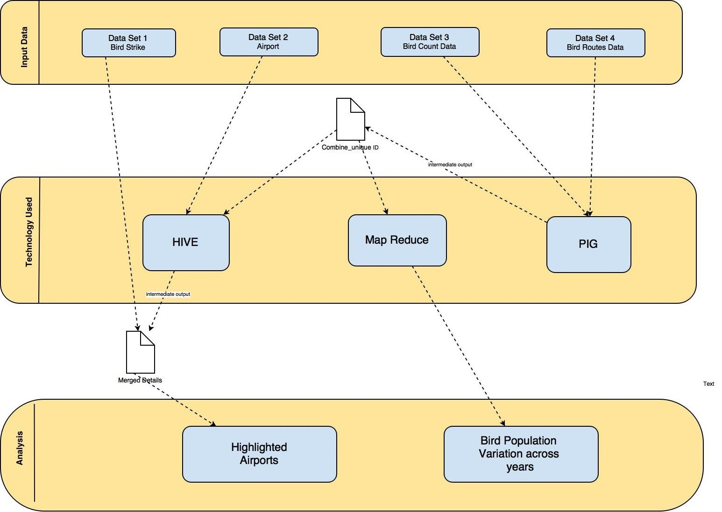
Determining Factors That Reduce Bird Strikes With Airplanes
Design Diagram:

Slide 5
Determining Factors That Reduce Bird Strikes With Airplanes
Platform(s) on which the analytic ran:
NYU HPC Cluster
Cloudera Quickstart VM

Slide 6
Determining Factors That Reduce Bird Strikes With Airplanes
Steps
Filtering the Airport and Bird Routes dataset to contain only data for country USA
Filtering Bird Count dataset to contain only stop 1 count
Data Cleaning
To find the Bird Count for all the routes by joining the two birds data
Concatenating the fields “Statenum” and “Route” in both the files to serve as a unique ID for the join.
Adjusting the table schema to generate unique Identifier for each row
Concatenating the latitude and longitude fields in the above table
Cross join on the concatenated table and airports table to get the nearby airport locations
Extracting the details of the airports along with the sum of stop1 bird counts and plotted this with tableau
To figure out the Airports that lie close to the locations for which we have bird counts
To get the bird population variation at each location w.r.t years
Summing up the bird population of all species for a location for every year.
To compare our Results with the bird Strike data
Grouping the same airport names and getting the total bird Strikes
Getting the airport names that match our output, along with the actual number of strikes

Slide 7
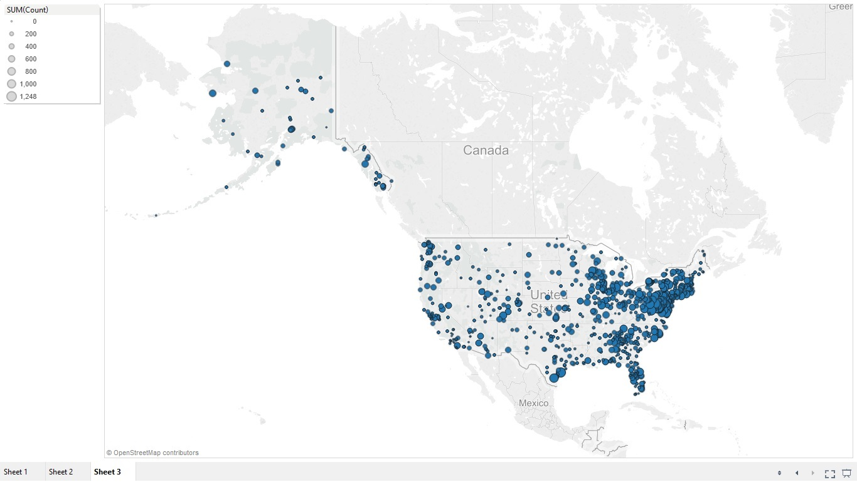
Determining Factors That Reduce Bird Strikes With Airplanes
Results
1. Airports in proximity (~18 mi) of areas of bird populations

Slide 8
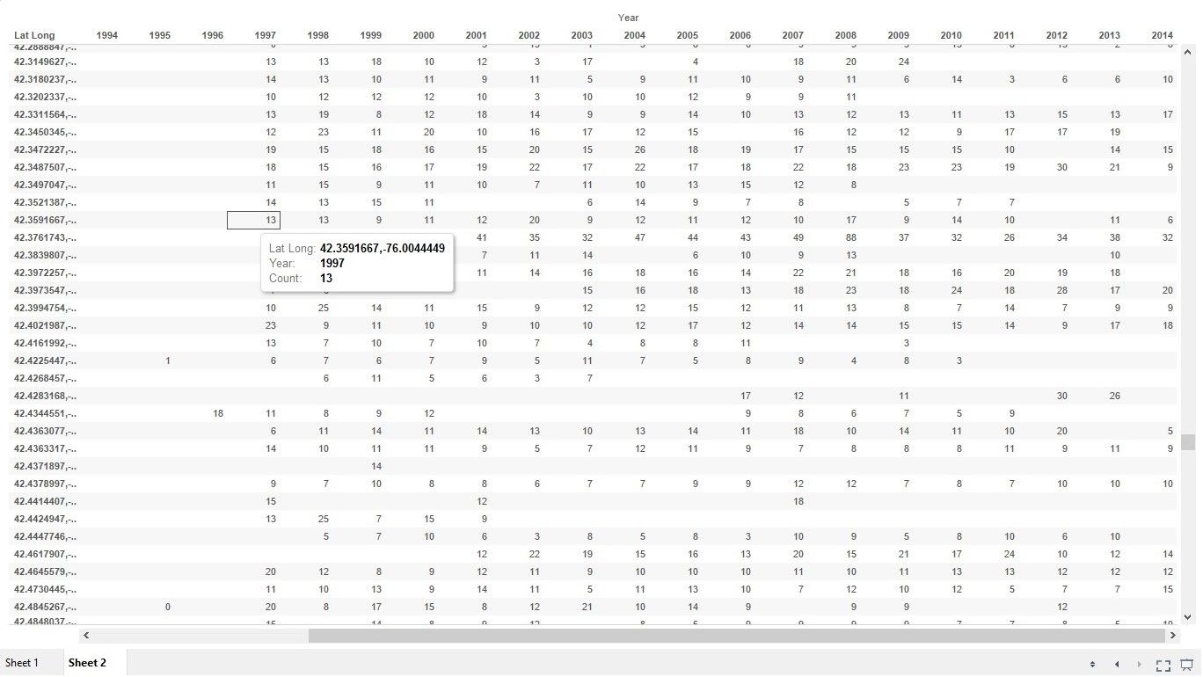
Determining Factors That Reduce Bird Strikes With Airplanes
Results:
2. Changes in bird population over the years on bird migration routes

Slide 9
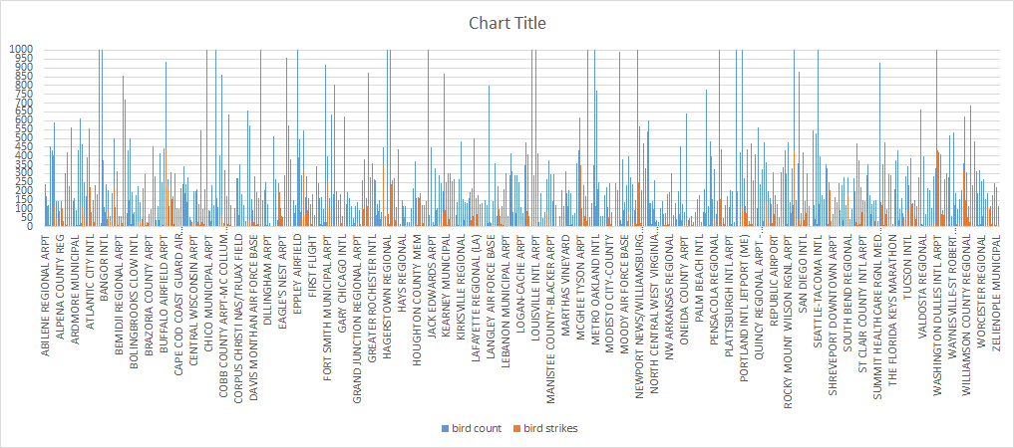
Determining Factors That Reduce Bird Strikes With Airplanes
Results:
3. Analyzing correlation between bird strikes and bird populations close to airports
Correlation : 0.2881409

Slide 10
Determining Factors That Reduce Bird Strikes With Airplanes
Obstacles
1. Coinciding the airport geolocation coordinates with bird migration routes
2. Matching airport incompatible location formats across with the FAA bird strike database and NABBS database

Slide 11
Determining Factors That Reduce Bird Strikes With Airplanes
Summary
As stated earlier about bird strikes being a significant threat to flight safety, we identified the airports that are around areas coinciding with a sizable bird population and thereby more prone to experiencing and reporting bird strikes. We proved this hypothesis by comparing our results with the actual bird strike data, with a considerable yet irrefutable amount of accuracy. Further, to strengthen the analysis we found the bird population variation across the years, thus suggesting the exploration of more precautionary measures that could be used by the airports list produced from our analytic to reduce bird strikes.
Acknowledgements
We would like to thank New York University for its HPC cluster which we used for MapReduce computations.
We are also grateful to the North American Breeding Bird Survey and Federal Aviation Administration for providing us with the bird migration and bird strike data.
We thank Google for its Maps API and Apache for everything.

Slide 12
Determining Factors That Reduce Bird Strikes With Airplanes
References
1. T. White. Hadoop: The Definitive Guide. O’Reilly Media Inc., Sebastopol, CA, May 2012.
2. https://en.wikipedia.org/wiki/Bird_strike
3. http://wildlife.faa.gov/database.aspx
4. https://www.pwrc.usgs.gov/bbs/RawData/Choose-Method.cfm
5. Boeing: Strategies for Prevention of Bird Strike Events, 2011 http://www.boeing.com/commercial/aeromagazine/articles/2011_q3/4/
6. Allan, John R.; Alex P. Orosz "The costs of bird strikes to commercial aviation", August, 2001

Slide 13
Thank you!

